Slide 1

Interactive Animations and Games
Lesson 14
Mini Project: Animation
Notes:
Lesson Plan: https://studio.code.org/s/csd3-2023/lessons/14

Slide 2
Teacher Resources
For Teachers!
Lesson Overview
This lesson is a chance for students to get more creative with what they have learned as students are asked to combine different methods that they have learned to create an animated scene. Students first review the types of movement and animation that they have learned and brainstorm what types of scenes might need that movement. They then begin to plan out their own animated scenes, which they create in Game Lab.
More guidance and resources for this lesson are available in the Lesson Plan:
https://studio.code.org/s/csd3-2023/lessons/14

Slide 3


Slide 4

Interactive Animations and Games Lesson 14 - Warm Up
Journal Prompt:
Write down as many types of movement and animations as you can remember from the previous lesson.
Make sure you know what blocks and patterns you need to make those movements, and when those movements would be useful.

Slide 5
Interactive Animations and Games Lesson 14 - Warm Up
Question of the Day
How can we combine different programming patterns to make a complete animation?

Slide 6
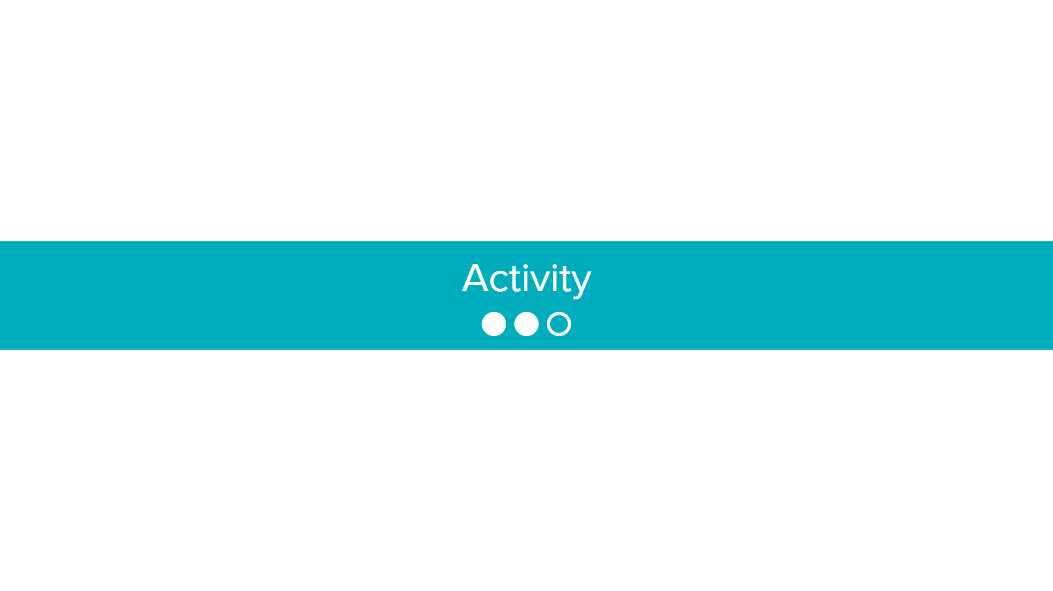

Slide 7

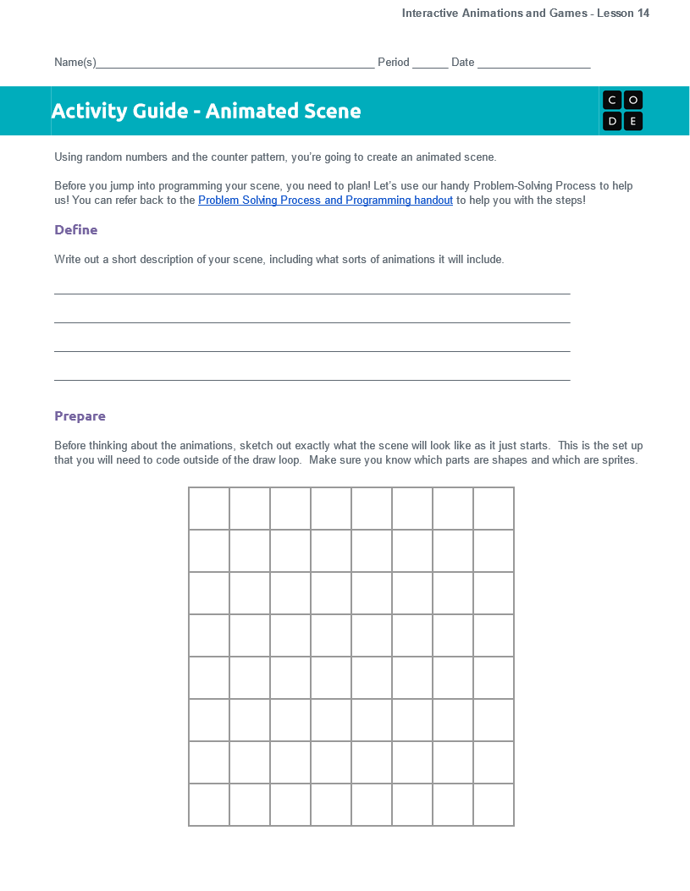

Interactive Animations and Games Lesson 14 - Activity
Distribute
You should have:
Animated Scene Planning Activity Guide
Pen/Pencil

Slide 8
Interactive Animations and Games Lesson 14 - Activity
Animated Scenes
Sample Scene
Take a look at the example in Code Studio and think about what you'd like to make.
What movements do you see in this scene?
Which movements use random numbers?
Which movements use the counter pattern?

Slide 9
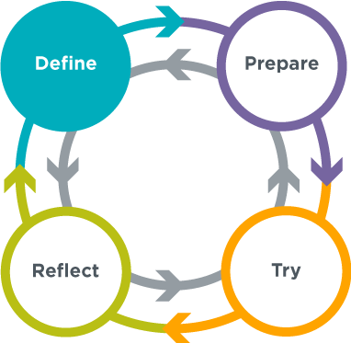
Interactive Animations and Games Lesson 14 - Activity
Animated Scenes
Define - Describe your idea
Write out a short description of your scene, including what sorts of animations it will include.
What will the scene look like?
How will it change/animate over time?
Are the animations random or planned movement?

Slide 10
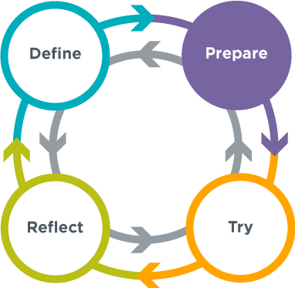
Interactive Animations and Games Lesson 14 - Activity
Animated Scenes
Prepare - Plan Your Animation
Draw a detailed sketch of your animation.
Are they shapes or sprites?
Describe the sprites you will need.
Describe your animations and how you will code them.
Will you use random numbers or the counter pattern?

Slide 11
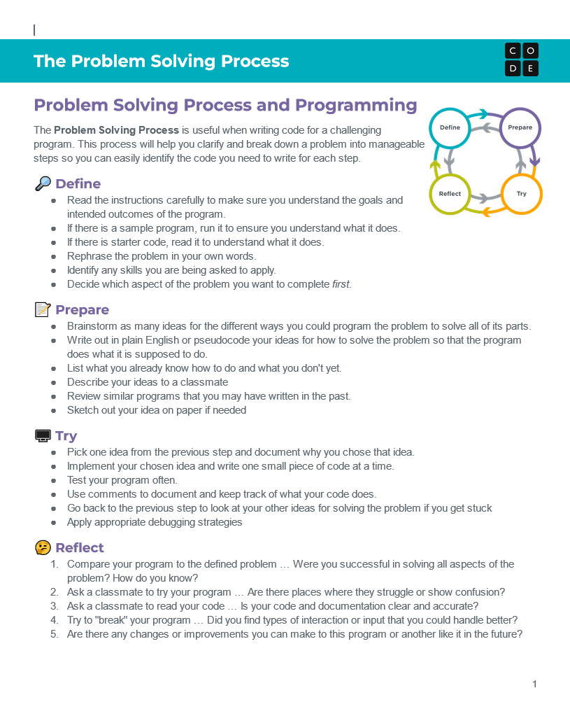
Interactive Animations and Games Lesson 14 - Activity
Distribute
You should have:
Problem Solving Process and Programming Resource
Pen/Pencil

Slide 12
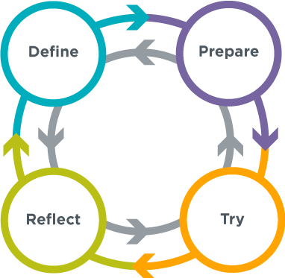
Interactive Animations and Games Lesson 14 - Activity
The Problem Solving Process

Slide 13
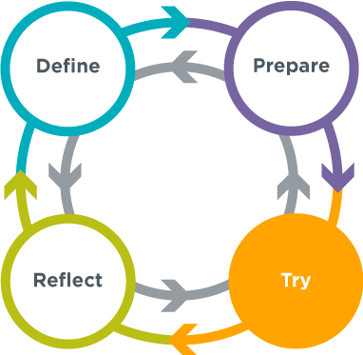
Interactive Animations and Games Lesson 14 - Activity
Animated Scenes
Try - Code Your Scene
Use your plan to code your scene, following the level instructions in Code Studio
Create the background
Add sprites
Add text
Add movement

Slide 14
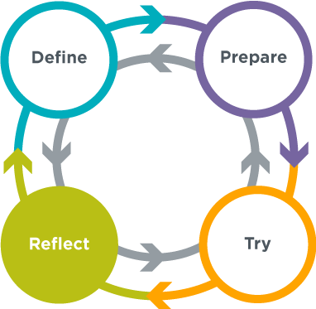
Interactive Animations and Games Lesson 14 - Activity
Animated Scenes
Review Your Scene
Check over your scene one last time to make sure you have included everything you want.
Did you follow your plan?
Are there any last changes you want to make?
What are you most proud of?

Slide 15
Interactive Animations and Games Lesson 14 - Activity
Animated Scenes
Gallery Walk
Look at the animations your classmates have created.
What is interesting about each animation?
How did they use their coding skills creatively?
Is there anything you see that you’d like to try?

Slide 16


Slide 17

Interactive Animations and Games Lesson 14 - Wrap Up
Journal Prompt:
What was one interesting way that you saw sprite movement used today?

Slide 18
Interactive Animations and Games Lesson 14 - Wrap Up
Question of the Day
How can we combine different programming patterns to make a complete animation?

